Slide 1
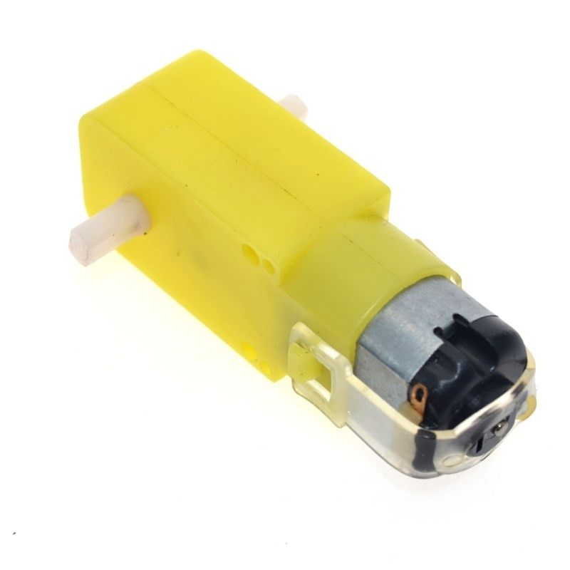

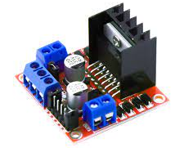
Arduino Course Session Two
PWM signal & DC motor control (& servo motor if possible)

Slide 2
Session 1 Wrap-Up
Installed and used Arduino IDE
Explored Arduino Layout
Digital Output functions (commands):
pinMode(<pin>, <usage>) e.g.(pinMode(9, OUTPUT);)
digitalWrite(<pin>, <HIGH/LOW>)
Delay
Average Voltage for high frequency signal

Slide 3
Session 2 Objective
Why voltage is averaged
PWM, what it is, how to use it, types of it
Serial Monitor
Variables
Transistors
Motors
H-Bridge
Bidirectional motors
Motor control IC

Slide 4
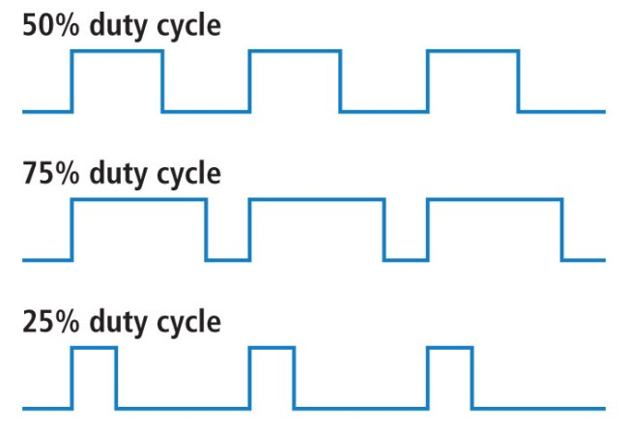
Averaging of High Frequency Signal (when using small amount of delay)
T=4ms
delay(3);
delay(1);
digitalWrite(pin, HIGH);
digitalWrite(pin, LOW);

Slide 5
Averaging of High Frequency Signal (when using small amount of delay)

Slide 6
Pulse Width Modulation (our version)
Pulse Width
Pulse
Pulse Width Modulation:
digitalWrite(pin, HIGH);
delay(pulse width);
digitalWrite(pin, LOW);
delay(period – pulse width)

Slide 7
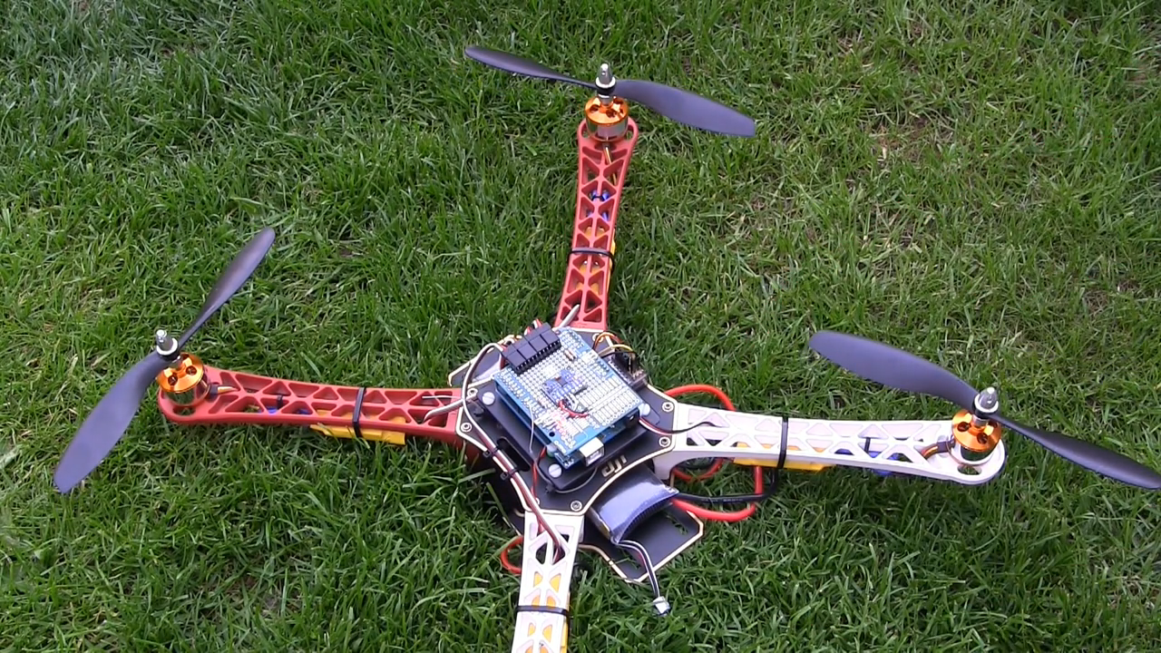
Problem of software PWM

Slide 8
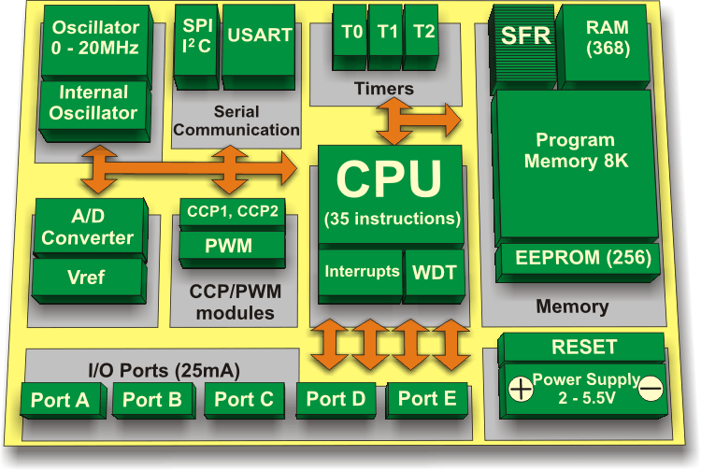
Hardware PWM

Slide 9
Hardware PWM
Dedicated PWM device built-in Arduino
Function to control it:
analogWrite(pin, value);
This value is base on pwm device resolution, in Arduino Uno it is 8-bit so 0 till 255

Slide 10
Basic Serial Communication with Laptop
Setup the communication device to open a serial port with the PC
Use function <Serial.Println(<string/int>) to send the string or integer to the serial monitor
Note: Serial Communication is a broad way of communication containing many protocols, the protocol we are currently using for code upload and printing over serial is called UART

Slide 11
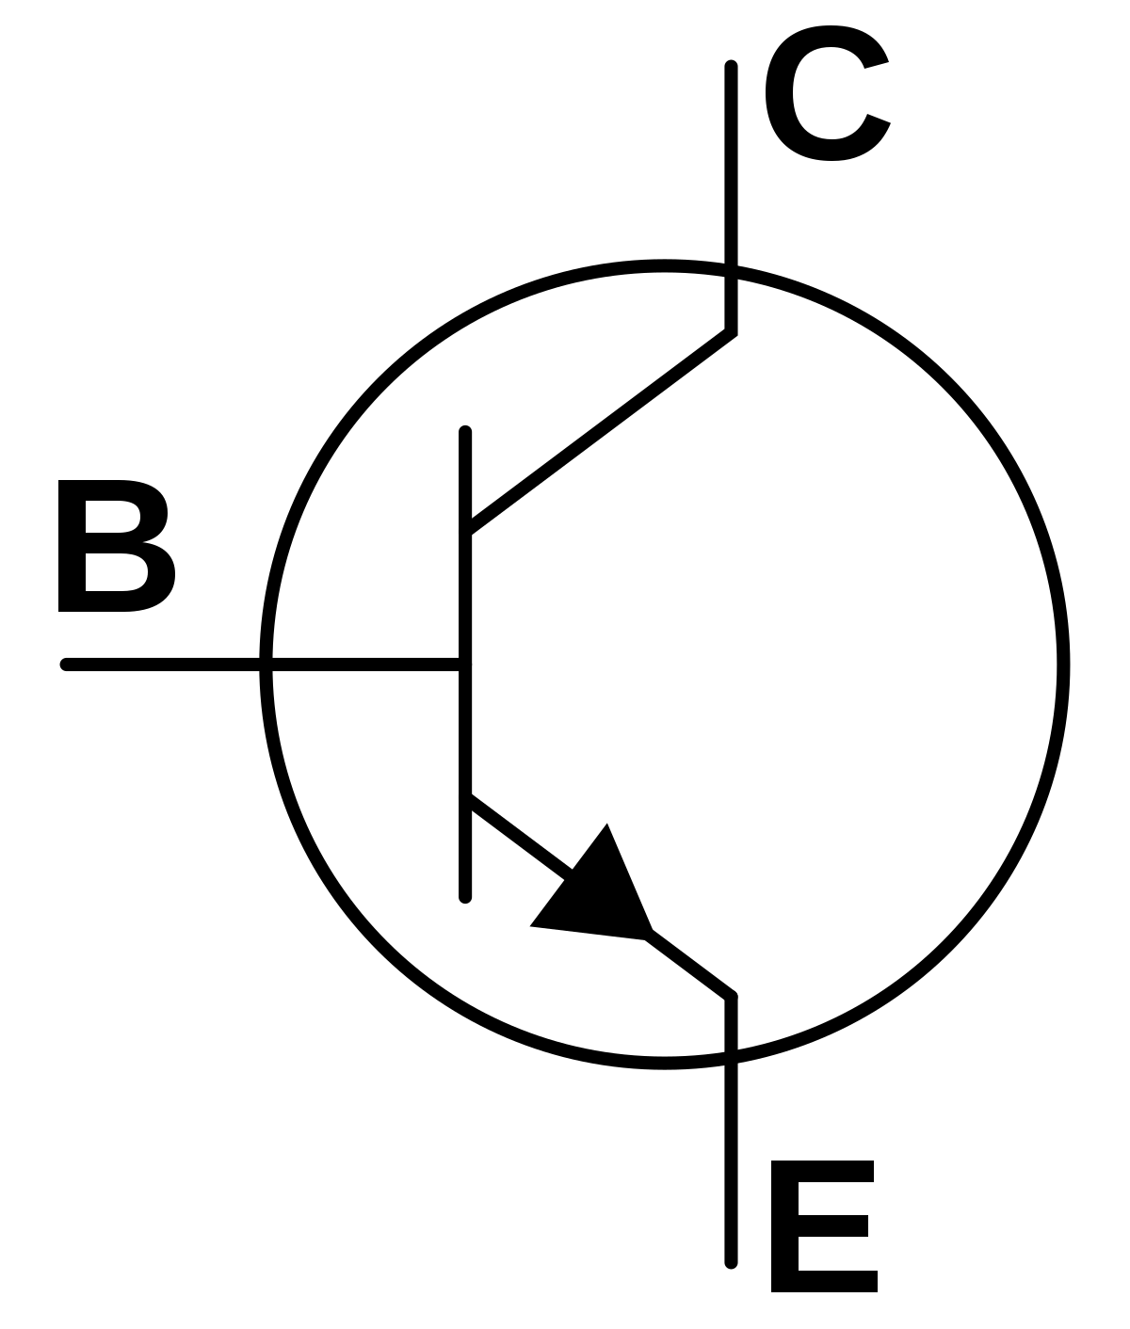
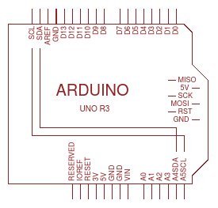
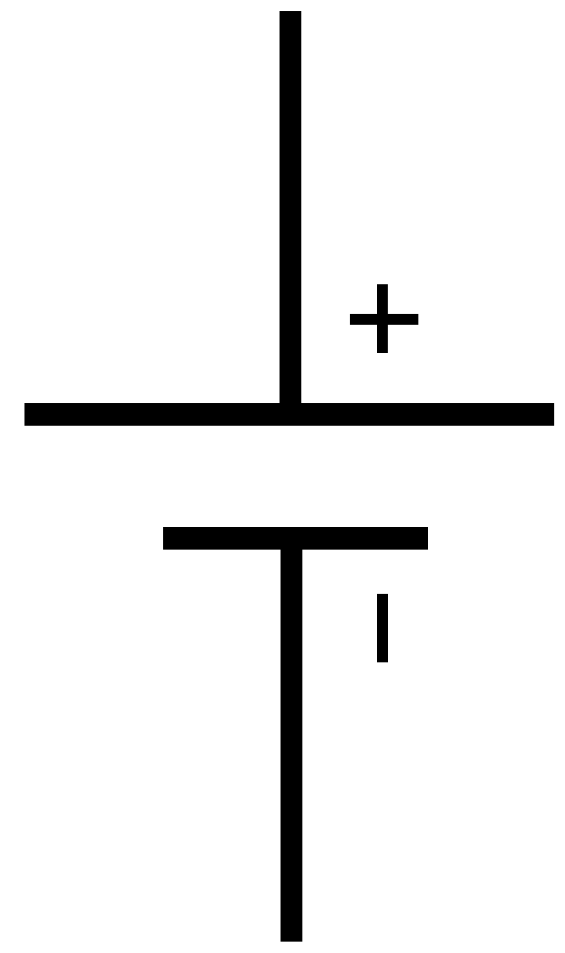
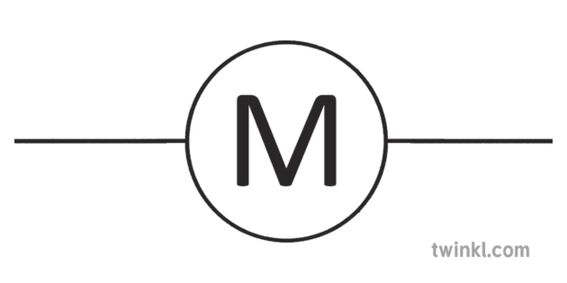
Bidirectional Motor Control – H bridge

